Slide 1


Mehul Trivedi
9/18/2023

Slide 2
Outline
Executive Summary
Introduction
Methodology
Results
Conclusion
Appendix

Slide 3

Executive Summary
Summary of methodologies
Data Collection
Data wrangling
Exploratory Data Analysis (EDA) with visualization
EDA with SQL
Building interactive map with Folium
Building dashboard with Plotly Dash
Predictive Analysis
Summary of all results
EDA results
Interactive Analytics
Predictive Analysis Results

Slide 4

Introduction
We want to predict if the Falcon 9 first stage will land successfully. SpaceX advertises Falcon 9 rocket launches on its website with a cost of 62 million dollars; other providers cost upward of 165 million dollars each, much of the savings is because SpaceX can reuse the first stage. Therefore, if we can decide if the first stage will land, we can decide the cost of a launch. This information can be used if an alternate company wants to bid against SpaceX for a rocket launch.
Problems we want to find answers
What influences success rate for a rocket to land successfully?
Variables and parameters which are corelating to successful land of rocket?
What conditions Space X has to achieve successful land?

Slide 5

Section 1

Slide 6

Methodology
Data collection method:
REST Api (provided by Space X)
Web scrapping (Wikipedia pages for Space X launches)
Perform data wrangling
One hot encoding
Column removals
Transformations
Perform exploratory data analysis (EDA) using visualization and SQL
Perform interactive visual analytics using Folium and Plotly Dash
Perform predictive analysis using classification models

Slide 7

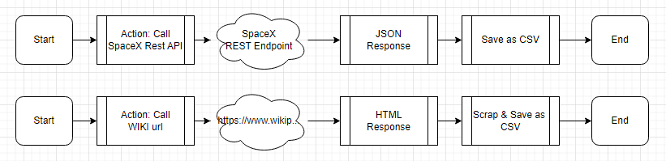
Data Collection
Data was collected in 2 parts
Space X REST api
Wikipedia pages
Following diagram depicts the flow(s) of data collection:

Slide 8
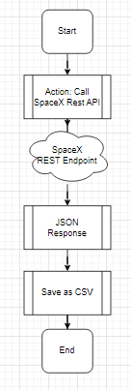
Data Collection – SpaceX API
The flow of data collection from SpaceX REST API is shown on left hand side
Following is the github link for notebook:
https://github.com/trivedimehulk/DataScienceJourney/blob/4d6feacec49442b6d50d7c4cff384467980da2f4/Capstone%20Assignment/jupyter-labs-spacex-data-collection-api.ipynb

Slide 9
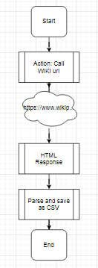
Data Collection - Scraping
The flow of data collection from Wiki pages with webscrapping is shown on left hand side
Following is the github link for notebook:
https://github.com/trivedimehulk/DataScienceJourney/blob/62b234a755947fc2fd9460ead0e296f2092ca4f8/Capstone%20Assignment/jupyter-labs-webscraping.ipynb

Slide 10
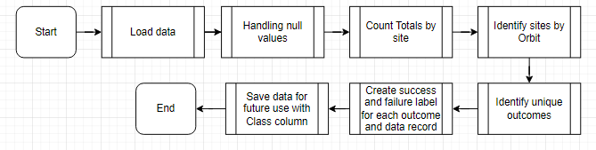
Data Wrangling
In this section, data wrangling is executed where we are finding class of success or failure for each record. This column will play a crucial role in overall prediction model building and analysis. Following is the process flow to wrangle the data
Git url for notebook: https://github.com/trivedimehulk/DataScienceJourney/blob/e5d11e697a3ee37ef405b6a56169966d8f748119/Capstone%20Assignment/labs-jupyter-spacex-data_wrangling_jupyterlite.jupyterlite%20(1).ipynb

Slide 11
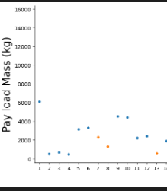
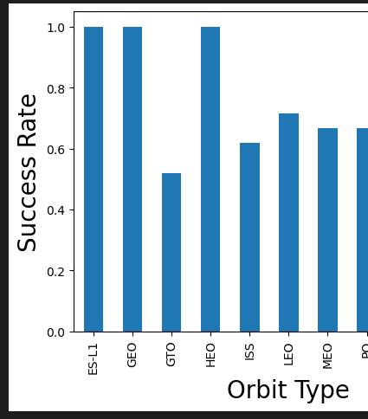
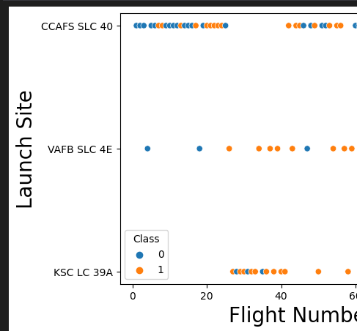
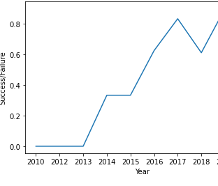
EDA with Data Visualization
Following charts were plotted from wrangled data for visual analysis. This step gave us insights to focus on features more important for prediction outcomes.
Git url for notebook: https://github.com/trivedimehulk/DataScienceJourney/blob/3ead759c9ceb43dbcbf5ce59ca878c9ed579ef4b/Capstone%20Assignment/jupyter-labs-eda-dataviz.ipynb.jupyterlite%20(1).ipynb

Slide 12
EDA with SQL
Following SQL queries were performed to analyse the data:
Find distinct launch sites
Find launch site records starting with "CCA"
Display the total payload mass carried by boosters launched by NASA (CRS)
Display average payload mass carried by booster version F9 v1.1
List the date when the first succesful landing outcome in ground pad was acheived.
List the names of the boosters which have success in drone ship and have payload mass greater than 4000 but less than 6000
List the total number of successful and failure mission outcomes
List the names of the booster_versions which have carried the maximum payload mass. Use a subquery
List the records which will display the month names, failure landing_outcomes in drone ship ,booster versions, launch_site for the months in year 2015.
Rank the count of landing outcomes (such as Failure (drone ship) or Success (ground pad)) between the date 2010-06-04 and 2017-03-20, in descending order.
Git url for notebook: https://github.com/trivedimehulk/DataScienceJourney/blob/3ca1c53837da4e5dfea401083b829fd1d4eca721/Capstone%20Assignment/jupyter-labs-eda-sql-coursera_sqllite%20(1).ipynb

Slide 13
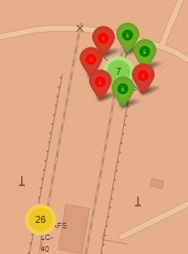
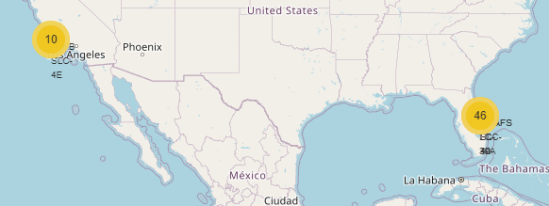
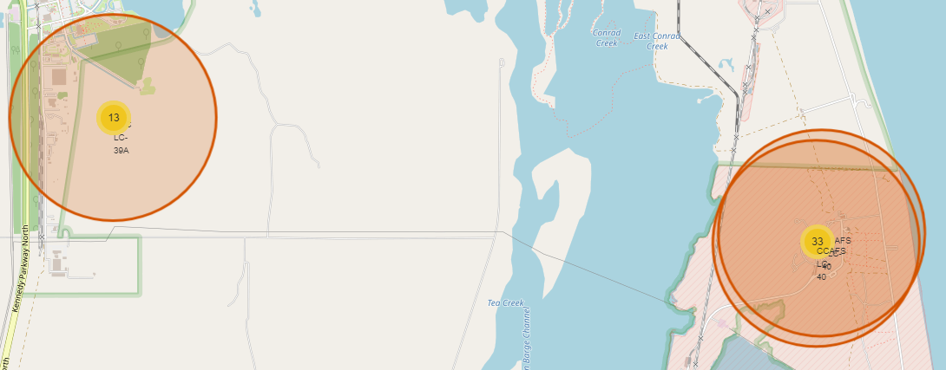
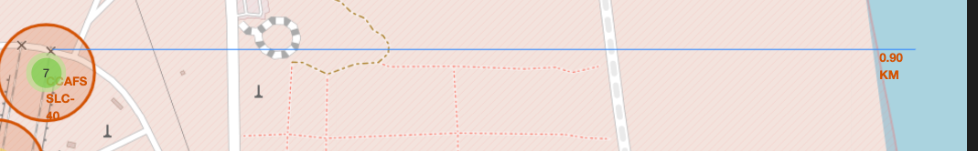
Build an Interactive Map with Folium
The launch success rate may depend on many factors such as payload mass, orbit type, and so on. It may also depend on the location and proximities of a launch site, i.e., the initial position of rocket trajectories.
Using folium maps, markers, line objects for distance and class factors were vital to identify best possible location for higher success ratio
Git url for notebook: https://github.com/trivedimehulk/DataScienceJourney/blob/d9b0d7eef712fd5308373c4a3da595f3a028210b/Capstone%20Assignment/lab_jupyter_launch_site_location-folium.jupyterlite.ipynb

Slide 14
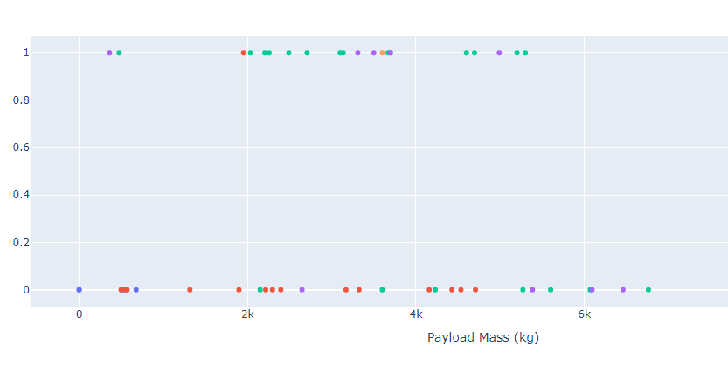
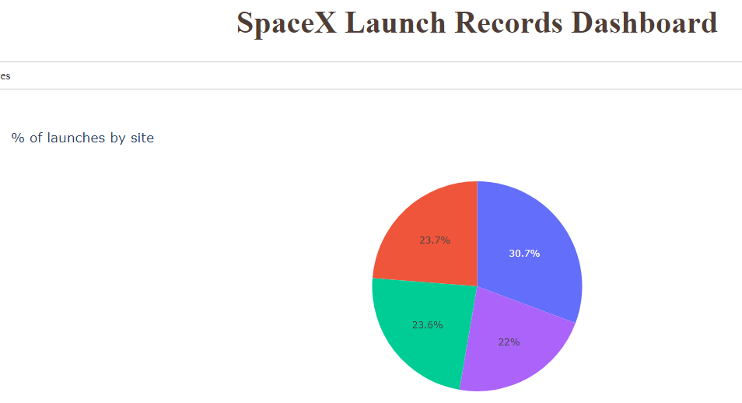
Build a Dashboard with Plotly Dash
As part of visual dashboard representation for leadership, following live charts were added to dashboar using Plotly. These charts helped analyse and pin point more feature grooming towards prediction building
Git url for notebook: https://github.com/trivedimehulk/DataScienceJourney/blob/923302965af4b8d38917b306f6a83ef5074c19da/Capstone%20Assignment/SpacxProj-dash-ass1.py

Slide 15

Predictive Analysis (Classification)
Summary steps on building the model
Build
Load and Use NumPy and Panda
Transform
Test/Train split
GridSearchCV improvements
Evaluate
Check Accuracy
Test and Train Split
Confusion Matrix
Improve
Feature Engineering
Algo Tunning
Compare
Git url for notebook: https://github.com/trivedimehulk/DataScienceJourney/blob/6d1e956959d609ce2626c2c3bcd5f16ed9035b0b/Capstone%20Assignment/SpaceX_Machine_Learning_Prediction_1.ipynb

Slide 16
Results
Exploratory data analysis results
Interactive analytics demo in screenshots
Predictive analysis results

Slide 17

Section 2

Slide 18
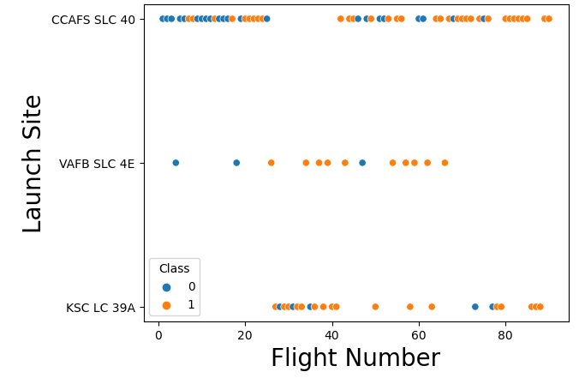
Flight Number vs. Launch Site
Analysis:
It is clearly visible that site KSC LC 39A had most successfully launches gradually

Slide 19
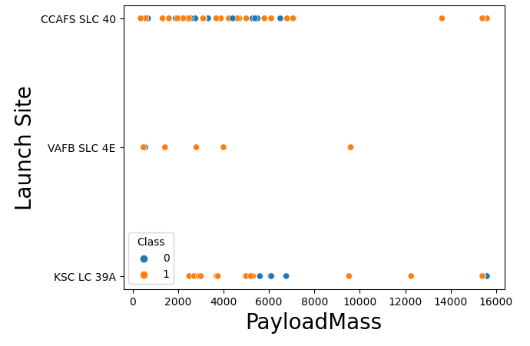
Payload vs Launch Site
Analysis:
Gradually as the mass increased, launch sites had lesser launches. Smaller the mass, more was the possibility of successfully launch

Slide 20
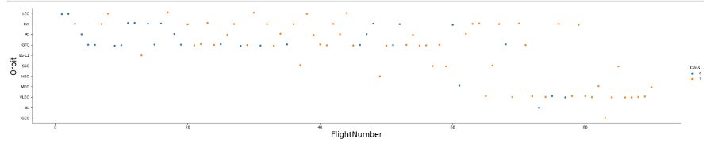
Flight vs Orbit Type
Analysis:
Other then LEO orbit, no other orbit has any corelation with Flight Number

Slide 21
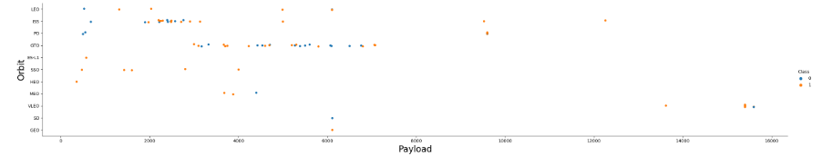
Payload vs Orbit Type
Analysis:
Its clearly evident as the mass increases, there are lesser chances of successful launch

Slide 22
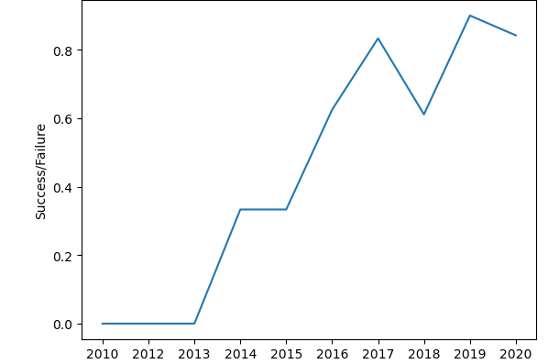
Launch Success Yearly Trend
Analysis:
SpaceX has gradually improved their processes YoY which shows their success ratio going up year by year

Slide 23

All Launch Site Names
Unique launch sites
CCAFS LC-40
VAFB SLC-4E
KSC LC-39A
CCAFS SLC-40
Query
%sql select DISTINCT Launch_Site FROM SPACEXTABLE

Slide 24
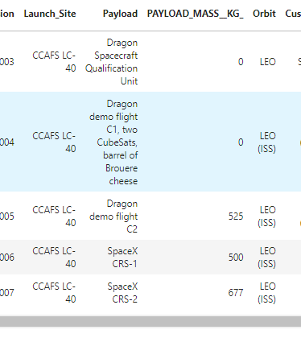
Launch Site Names Begin with 'CCA'
Query:
%sql select * FROM SPACEXTABLE WHERE Launch_Site like 'CCA%' LIMIT 5

Slide 25
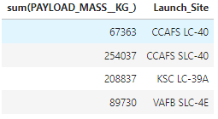
Total Payload Mass
Query:
%%sql
select sum(PAYLOAD_MASS__KG_), Launch_Site FROM SPACEXTABLE
Group By Launch_Site

Slide 26
Average Payload Mass by F9 v1.1
Average payload mass carried by booster version F9 v1.1: 2928.4
%%sql select avg(PAYLOAD_MASS__KG_) FROM SPACEXTABLE where Booster_Version='F9 v1.1'

Slide 27
First Successful Ground Landing Date
Successful landing outcome on ground pad [2015-12-22]
%%sql select min(Date) FROM SPACEXTABLE where Landing_Outcome='Success (ground pad)'

Slide 28
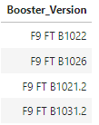
Successful Drone Ship Landing with Payload between 4000 and 6000
Query:
%%sql select Booster_Version from SPACEXTABLE where Landing_Outcome='Success (drone ship)' and PAYLOAD_MASS__KG_>4000 and PAYLOAD_MASS__KG_<6000

Slide 29
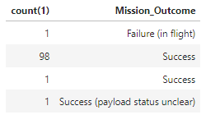
Total Number of Successful and Failure Mission Outcomes
Query:
%%sql select count(1), Mission_Outcome FROM SPACEXTABLE Group By Mission_Outcome

Slide 30
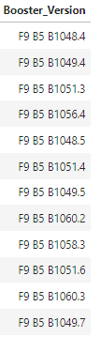
Boosters Carried Maximum Payload
Query:
%%sql select Booster_Version FROM SPACEXTABLE where PAYLOAD_MASS__KG_= (select max(PAYLOAD_MASS__KG_) FROM SPACEXTABLE )

Slide 31
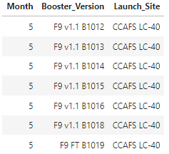
2015 Launch Records
Query:
%%sql select substr(Date, 4, 1) as Month,Booster_Version, Launch_Site FROM SPACEXTABLE where substr(Date,0,5) = '2015'

Slide 32
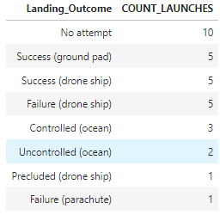
Rank Landing Outcomes Between 2010-06-04 and 2017-03-20
Query:
%sql SELECT Landing_Outcome, COUNT(*) AS COUNT_LAUNCHES FROM SPACEXTBL WHERE Date BETWEEN '2010-06-04' AND '2017-03-20' GROUP BY Landing_Outcome ORDER BY COUNT_LAUNCHES DESC;

Slide 33

Section 3

Slide 34
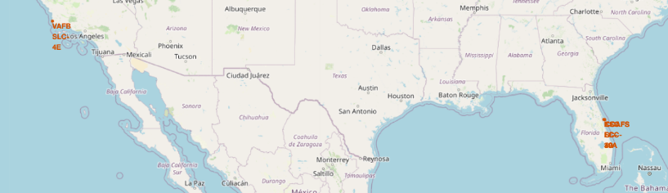
All Launch Sites On Geo Location
Above map shows all launch sites on a map. As we can see the launches are distributed on east and west side near the equator.

Slide 35
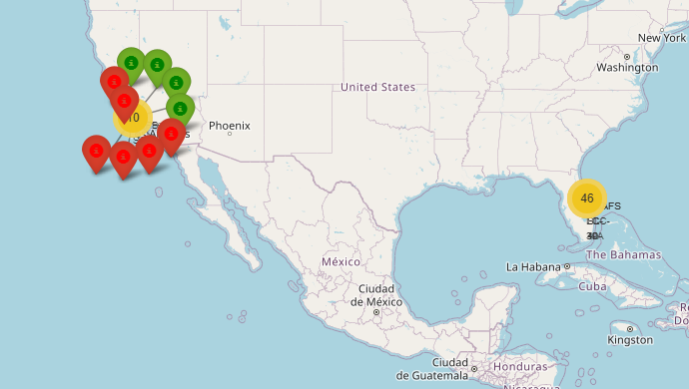
Success vs Failed Launch by Geo location
The map shows the detailed level of success vs failed launches by geo location on the map

Slide 36
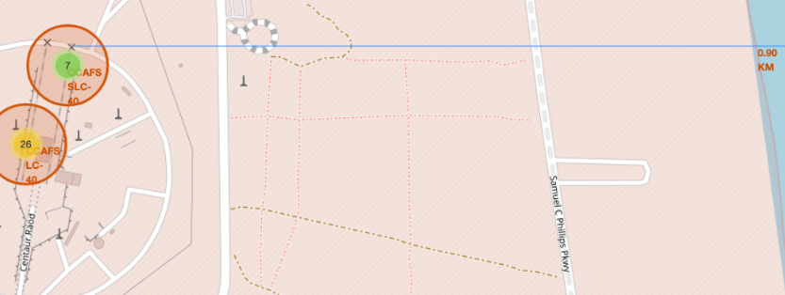
Launch Site Proximity to Coastal
Replace <Folium map screenshot 3> title with an appropriate title
Explore the generated folium map and show the screenshot of a selected launch site to its proximities such as railway, highway, coastline, with distance calculated and displayed
Explain the important elements and findings on the screenshot

Slide 37

Section 4

Slide 38
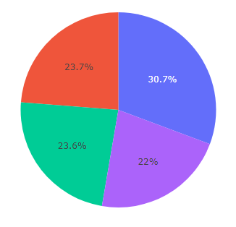
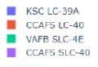
Dashboard
KSC LC-39A had most successful launches

Slide 39
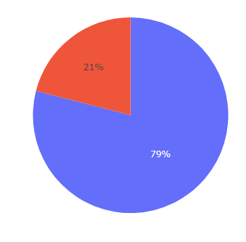
Dashboard – highest success launch rate

Slide 40
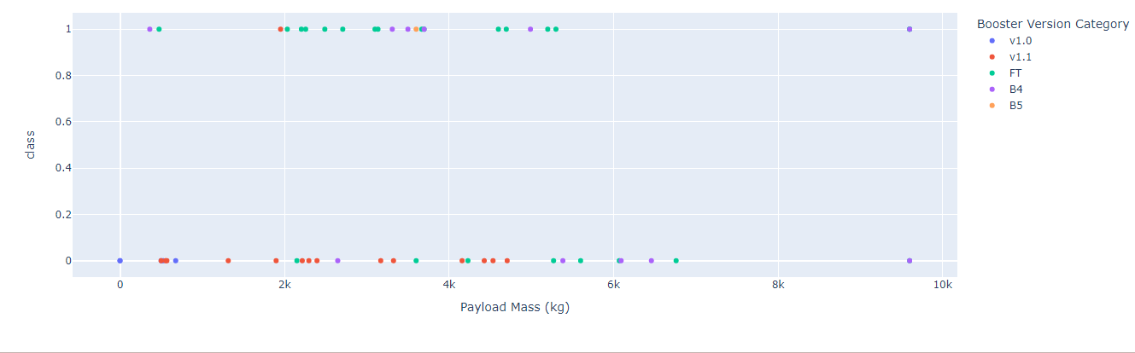
Payload mass vs Success Rate for Boosters
Payload mass vs Success with Booster Version Analysis

Slide 41

Section 5

Slide 42
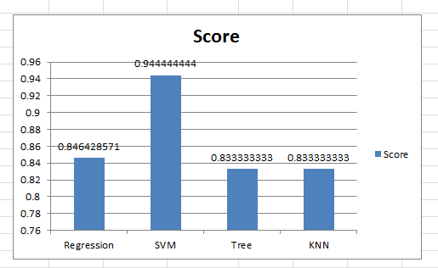
Classification Accuracy
The winner is SVM for this dataset. The bar chart shows the comparison for the same.

Slide 43
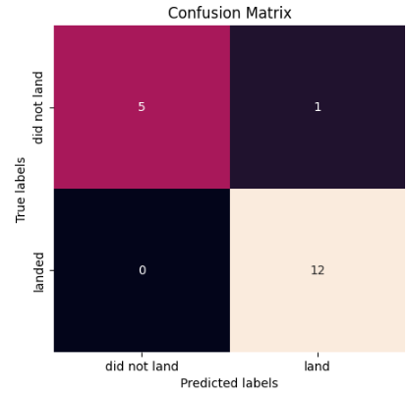
Best Confusion Matrix
Examining the cm, we can see SVM can distinguish between different classes. We can see that major problem is false positives.

Slide 44

Conclusions
SVM algorithm is best for this dataset
Low weighted payload has more success rate
Comparing years, the company has improved the success rate thus their processes for the same
Notable successful launch sites and launch boosters are presented in detailed slides

Slide 45
Appendix
Include any relevant assets like Python code snippets, SQL queries, charts, Notebook outputs, or data sets that you may have created during this project

Slide 46


